Slide 1

Machine Learning Project
Team:
Assem, Madina, Umut

Slide 2

IDEA
Identifying the genre of song by its lyrics

Slide 3
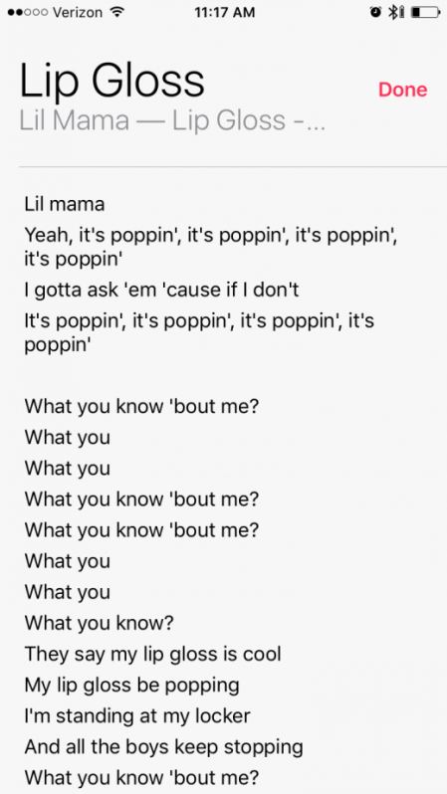
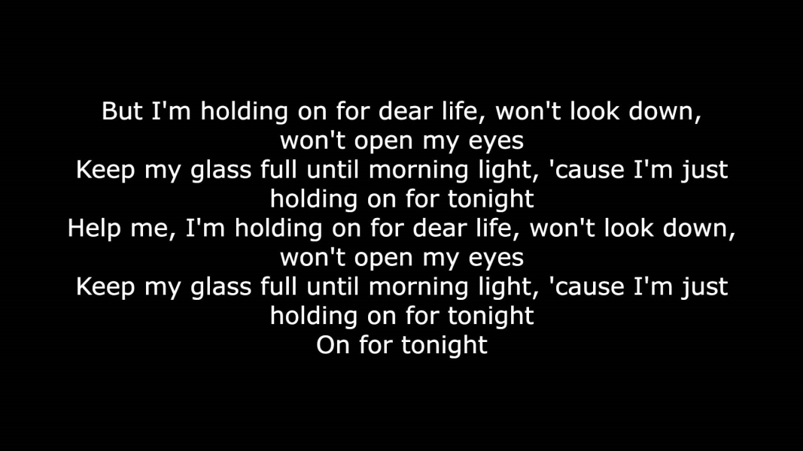
Input data (X)
lyrics

Slide 4

Output data (Y)
Possible genre of music and it’s lyrics

Slide 5
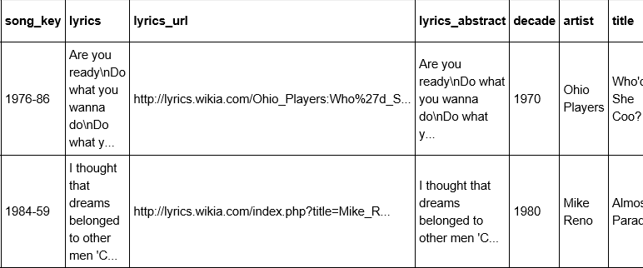
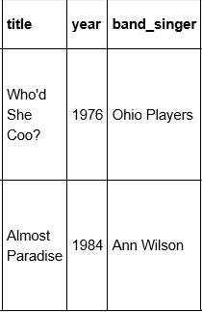
Example of dataset

Slide 6

Сompetitors analysis
2 drawbacks (TF-IDF) ~ 80% accuracy:
Too simple statistical measure used to assess the importance of a word in a contract document
Incorrectly classifies the genre of
music by lyrics

